Slide 1
Integrated Nutrient Management in Coffee
ADB TA 6898-REG: (IND) Climate-Resilient Farmer Group Development to Support Covid-19 Recovery for Smallholder Coffee Farmers

Slide 2
Contents
Characteristics of coffee soils
Soil testing
Importance of soil testing
How to draw soil samples
Soil amendments – for correcting soil pH & its significance
Essential nutrients for plant growth & development
Functions of nutrients
Deficiency symptoms
Sources of nutrition - fertilizers, organic manures & biofertilizers
Fertilization of coffee plants
Nutrient requirement of coffee
Integrated Nutrition Management
Things to remember

Slide 3
Characteristics of coffee soils
Should be deep (≥70 cm) with good porosity (> 100 mm per meter) to allow good drainage and root penetration
Water table 2 m below surface
pH – slightly acidic (6.2 to 6.5)
Rich in soil organic matter (~2%)

Slide 4
Soil Testing

Slide 5
Soil testing – why it is needed
To know the pH of soil and to correct the pH to suitable level using soil amendments
To know the soil fertility status (organic matter, major nutrients), which help in arriving at correct doses of fertilizers
To identify sufficiency/ deficiency of nutrients
Typically soil testing should be done once every 2-3 years

Slide 6
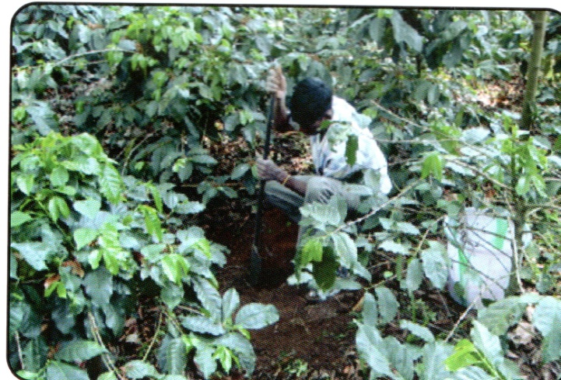
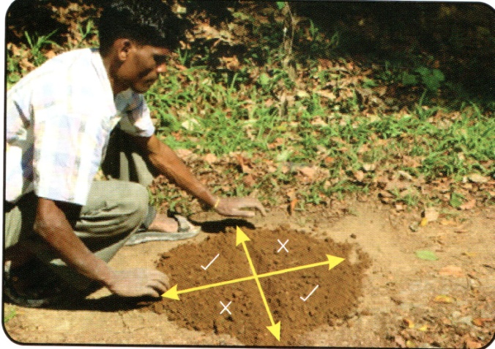
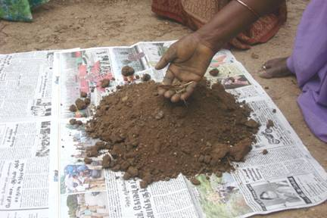
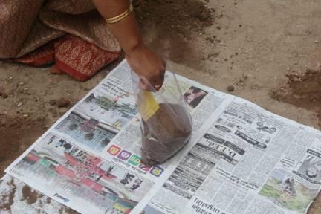
How to collect soil samples
Sample collection
Quartering method
Compound sample
Packing & labeling
Notes:
One sample for each representative block
Collect soil samples about 3-5 feet away from trunk
Make a pit of half feet diameter upto a depth of 1ft after removing surface leaf litter. Discard the soil. Scrape the soil from edges of the pit from top to bottom, mix well in the pit and collect the sample
Collect about 10 such samples from each presentative block
All samples from each block are mixed thoroughly after removing roots, stones etc. to prepare a compound sample.
From the compound sample, a representative sample is drawn by following quartering method.
The final sample is packed in polythene bags and labelled for sending to testing lab.

Slide 7
Soil amendments for correcting soil pH
Optimum pH for normal growth of coffee and efficient use of applied nutrients is in the range of 6.2 to 6.5 (slightly acidic).
Coffee soils tend to become highly acidic (pH falling below 5) due to high rainfall, which leads to leaching of cations like K, Ca, Mg etc.
Under strongly acidic condition, most of the essential nutrients become unavailable to the plants
Under low pH condition the growth of beneficial microorganisms is curtailed
Hence it is important to correct the pH of coffee soils to maintain it around 6.2-6.5
Soil amendments like Ag. lime (calcium carbonate) and Dolomite (calcium, magnesium carbonate) are commonly used for correcting soil pH

Slide 8
Essential Nutrients

Slide 9
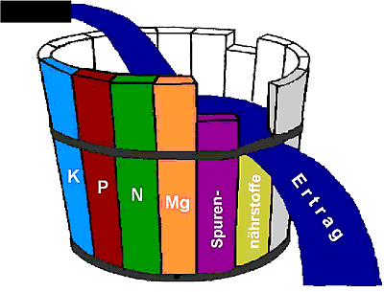
Essential Nutrients for plant growth
Major nutrients: Nitrogen (N), Phosphorus (P), Potassium (K)
Secondary nutrients: Calcium (Ca), Magnesium (Mg), Sulphur (S)
Micronutrients: Zinc (Zn), Boron (B), Iron (Fe), Copper (Cu), Molybdenum (Mo), Manganese (Mn), Chlorine (Cl)
Carbon (C), Hydrogen (H), Oxygen(O) available in the atmosphere
Jahr =>
1985
2005
Veränderung
Ertrag =>
58 dt/ha
80 dt/ha
+ 22 dt/ha
Nährstoffentzüge Korn + Stroh, kg/ha
N
139
192
+ 53
P
27
38
+ 11
K
87
120
+ 33
Mg
13
B
Zn
18
+ 5
S
17
24
+ 7

Slide 10
Function of nutrients
Nutrient | Functions | Peak Demand
Nitrogen | Vegetative growth | Throughout the year
Phosphorus | Root growth, flowering, fruiting, quality | Establishment stage, Flowering & fruit setting stages
Potassium | Fruit development, bean size, resistance to Pests & diseases | Berry maturation
Calcium | Resistance to drought, pests & diseases | Throughout the year
Magnesium | Yield, resistance to pests & diseases | Berry maturation stage
Sulphur | Resistance to pests & diseases, quality | Berry maturation stage
Micronutrients | Enhance FUE; assist in plant metabolic activity; Pest, disease & drought resistance; improve quality | Throughout the year

Slide 11
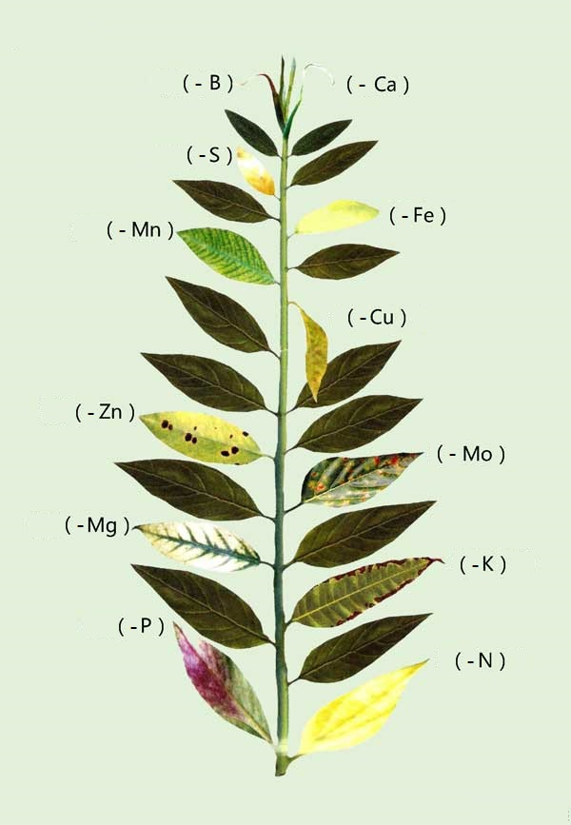
Nutrient
Deficiency
Symptoms
Source: acefertilizer.com

Slide 12
Sources of Nutrients

Slide 13
Sources of plant nutrients
Fertilizers
Straight fertilizers, Complex fertilizers, Mixed fertilizers, micronutrient formulations
Organic manures
FYM, Compost, Vermicompost
Biofertilizers
N-fixers, P-solubilizers, VAM

Slide 14
Common commercial fertilizers used in coffee
Fertilizer | N (%) | P₂O₅ (%) | K₂0 (%) | CaO (%) | MgO (%) | S (%)
Urea | 46 | - | - | - | - | -
Rock Phosphate | - | 16-18 | - | - | - | -
Muriate of Potash (KCl) | - | - | 60 | - | - | -
Sulphate of Ammonium (SA) | 21 | - | - | - | - | 23
Di-ammonium Phosphate (DAP) | 18 | 46
Single Super Phosphate (SSP) | - | 16-20 | - | - | - | 11-12
Fused Ca-Mg Phosphate | - | 14-16 | - | 28-30 | 18 | -
NPK (16:16:8) | 16 | 16 | 8 | - | - | -
NPK (16:8:16) | 16 | 8 | 16 | - | - | -
NPK (15:15:15) | 15 | 15 | 15 | - | - | -
NPKS (16:8:14:13) | 16 | 8 | 14 | - | - | 13
NPK (14:7:14) | 14 | 7 | 14 | - | - | -

Slide 15
Integrated Nutrient Management

Slide 16
Why Integrated Nutrient Management (INM)
Total dependence on chemical fertilizers to meet the nutrient requirement of plants is not advisable for the following reasons
Fossil fuels used in their production – contribute to climate change
Ground water contamination - NO₃
Volatilization of certain elements like No₂ - contributes to GHGs
Excess use affects soil health and makes the soil unproductive
Integrated Nutrient Management
Meeting the plant nutrient requirement with organic manures, biofertilizers and fertilizers
reduces chemical fertilizers and maintains soil health
sustainable coffee production

Slide 17
Essentials of INM
Improve S.O.M
Balanced Fertilization
INM
Organic Manures & Biofertilizers

Slide 18
In situ enrichment of organic matter
Shade trees contribute substantial qualities of biomass in the form of leaf litter which improves soil organic matter
During early stages of coffee establishment - growing of green manure crops with Crotolaria striata, C. anagyroides, Tephrosia vogelii and cover crops like cowpea, horse gram etc., improves soil organic matter (6-10 tons of dry matter/ ha)
Cover crops also help in suppression of weed growth
Organic matter helps retain moisture & nutrients and release them slowly to the plants. It also facilitates growth of beneficial microorganisms in the soil.

Slide 19
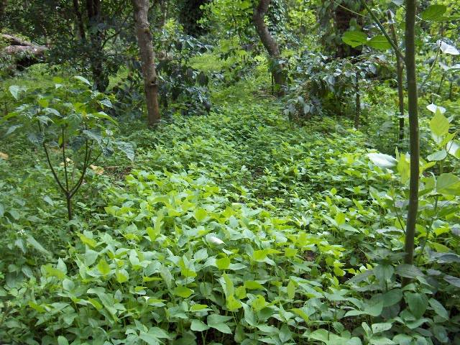
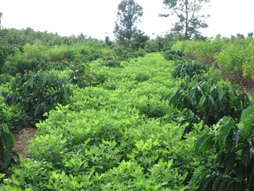
Wild groundnut as cover crop (Courtesy: WASI, Vietnam)
Cow pea as cover crop (Courtesy: CCRI, India)

Slide 20
Organic manures
All available biomass on the farm like cherry pulp/ husk can be composted along with weed and leaf biomass.
The composts can be enriched by mixing biofertilizers like P-solubilizers and VAM one week before field application.
Application of enriched composts @ 8-10 tons per ha once in 2 years improves soil organic matter content
Composts should be applied in furrows/ trenches (30cm width, 15-20 cm depth) 2-3 ft away from the tree trunk along the drip circle and covered with a layer of soil
Always decompose organic matter before application to avoid ants and harmful microorganisms
When organic manures/ composts are integrated into the nutrition management, the dosage of fertilizers can be reduced by one-third

Slide 21
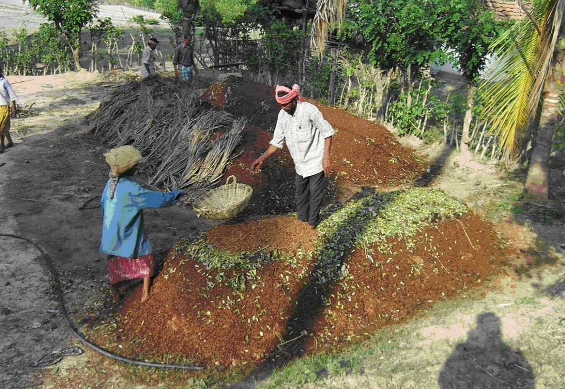
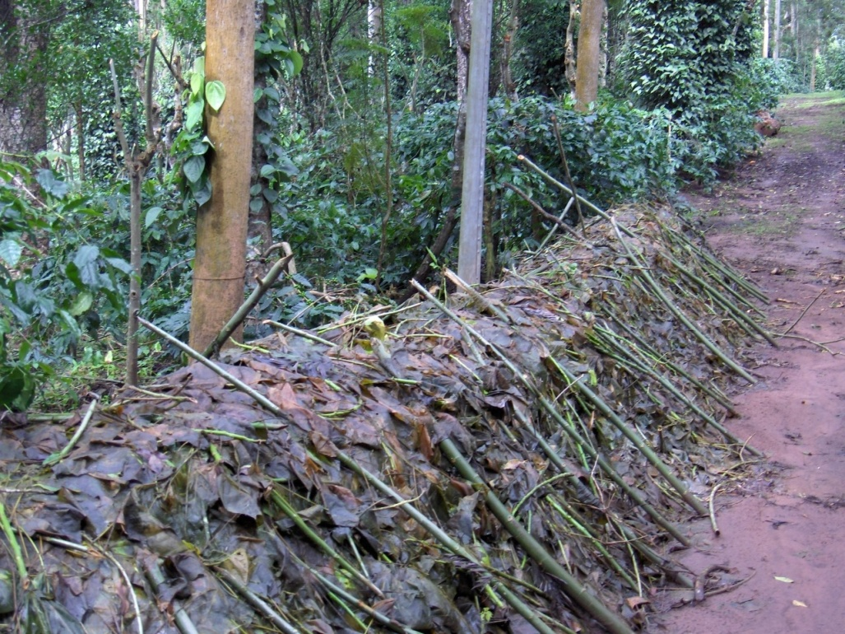
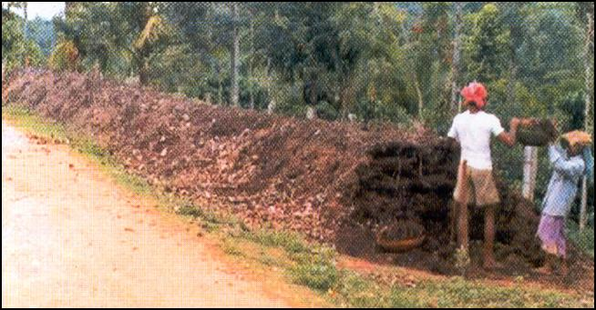
On-farm Composting
Images Courtesy: CCRI, India
Notes:
Aerobic method (heap method) is simple and effective for composting of organic material
Any biodegradable farm wastes could be composted. Main components
Farm wastes: eg. cherry husk, coffee pulp, crop residues like straw etc. would be the basic raw material.
Animal wastes: Cattle shed wastes, goat droppings, piggery and poultry wastes.
Green material: Any green plant material like leaves, prunings, weed biomass etc.
Enhancers: Urea/ super phosphate/ rock phosphate/ microbial consortia would speed up composting
Construct the heap (1.5-2.0m Width and convenient length) by putting farm wastes, animal wastes and green material layer by layer and sprinkle compost enhancers on each layer of green material
Cover with straw. Turn the heap once in 2-3 weeks for 2-3 times. Sprinkle water if needed.
Compost will be ready in about 3-4 months period. The fully ready compost will be coarse powder, dark brown to gray in colour & have an earthy smell

Slide 22
Balanced fertilization
Apply recommended fertilizers at least in 2 rounds per year, once at the beginning of rainy season and again towards the end of rainy season.
In case of irrigated fields, an additional split round of fertilization at the time of flowering is advantageous
The recommended phosphorus can be applied in one single dose towards the end of rainy season
Along with NPK, it is essential to apply secondary nutrients like Mg and S in the form of Mg SO₄ @ 25 kg/ ha by mixing with fertilizers before application
Micro nutrient sprays are suggested during post monsoon period especially after a bumper crop
Notes:
NUTRIENT REQUIREMENT FOR 1 TON OF COFFEE
Every 1 ton of Robusta beans remove 45kg N, 9.0kg P and 58kg K
Considering the NUE, about 112kg N; 60kg P₂O₅ and 128kg K₂O are removed by 1 ton of coffee
Additionally, about 13kg N, 2.5kg P and 15kg K is utilised for the biomass production.
The nutrients utilised for biomass production can be returned to soil by recycling through compost application
So it is essential to replenish the required quantities of nutrients through INM every year for sustained production
Source: Coffee Guide – A Manual on Coffee Cultivation, Published by Coffee Board of India, 2014

Slide 23
Things to remember while applying fertilizers
Testing of soil once in 2-3 years
Correction of soil pH (Ag.lime/ Dolomite) – essential to avoid over use of fertilizers
Straight (single source) fertilizers are cost effective over complex fertilizers
Apply fertilizers when there is sufficient moisture in the soil
Apply the fertilizers in a circular band the around the trunk by leaving a gap of 1-2 ft
For intercrops – adopt separate nutrition management as per recommendations

Slide 24
Thank You
Terima kasih

